Slide 1
Paired Passages
Synthesis Questions

Slide 2
Much like passages that include graphics, sections with paired passages will ask questions about:
Just 1 passage (claims, tone)
Similarities between the two (claims, tone)
Differences between the two (claims, tone)
Conclusions that can be made
How the authors of the passages may respond to the other’s claim

Slide 3
CONTEXT:
This can be very helpful to situate your thinking!
Passage 1=1924
Passage 2: 2005
So, are we going to see a difference in looking at Austen over time?
Or will these show a kind of enduring legacy?

Slide 4
CONTEXT:
This can be very helpful to situate your thinking!
Passage 1=1840
Passage 2: 1851
Written around the same time; so do they agree or disagree with each other, especially since one is a man, one is a woman?

Slide 5
CONTEXT:
This can be very helpful to situate your thinking!
Passage 1=1837
Passage 2: 1838
Written around the same time; so do they agree with each other? Do they see women’s involvement in abolition the same way?

Slide 6
PRACTICE
Note some highlighting and hints to help you select an answer.

Slide 7
NOTE: No context was provided with these passages because they are from an older book.

Slide 8
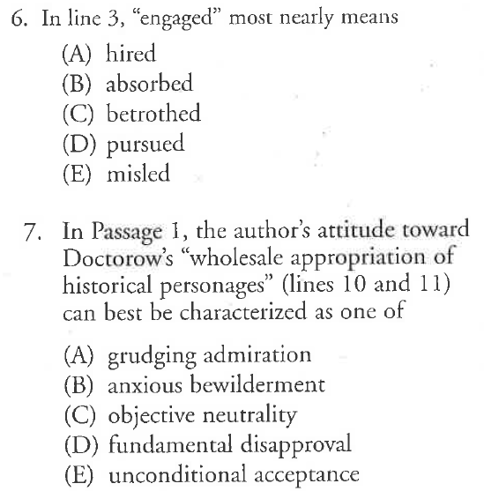
Hint: Think about how the author views Defoe’s technique in writing a character as compared to Doctorow’s.

Slide 9
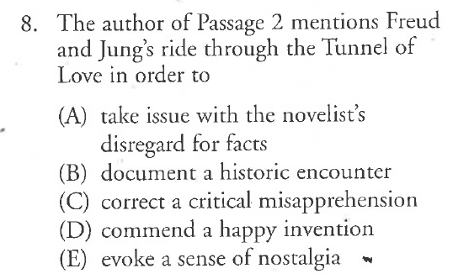

Slide 10
HINT: Consider which of these answer choices can be found in Passage 1 or in Passage 2.

